Slide 1
Developing a Multicurrency, Multisignature Wallet
Alex Melville

Slide 2




Alex Melville
Software Engineer @BitGo
World Traveler
github.com/Melvillian/talks

Slide 3
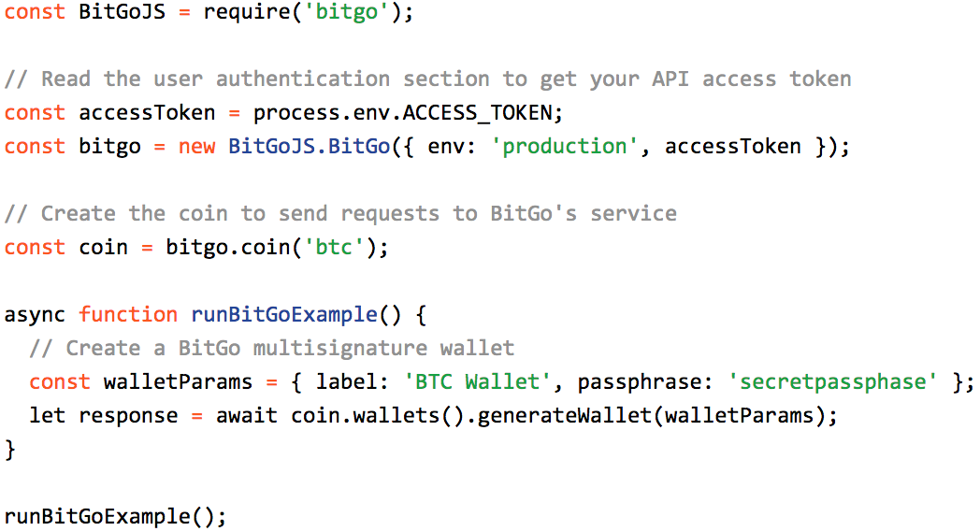

Slide 4
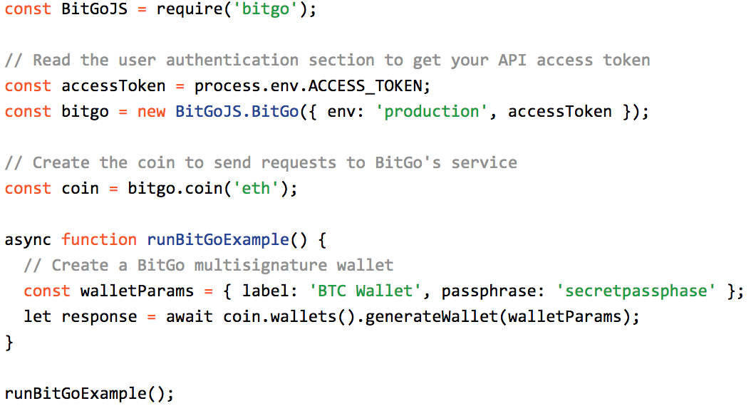

Slide 5

Security
Multisignature
HD Wallets (BIP 32)

Slide 6


Why Multisignature?
(Single-signature is less secure)

Slide 7

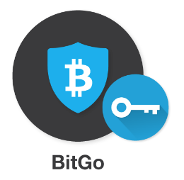
Why Multisignature?
User
(Single-signature is less secure)
Cosigner and charge for your service
TX
TX
TX

Slide 8
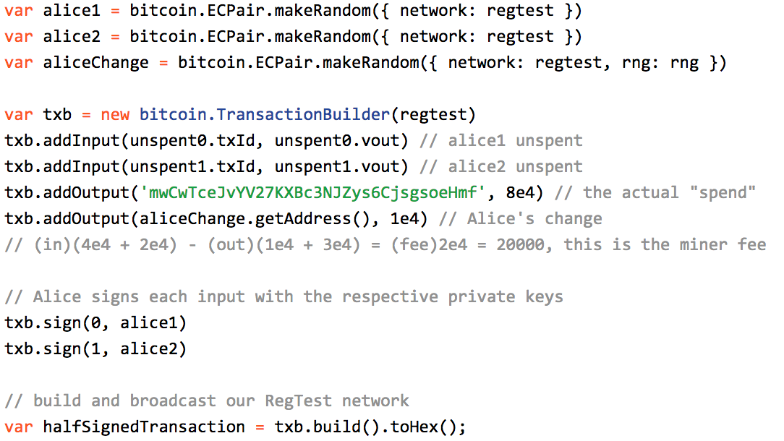
How does multisignature work?

Slide 9
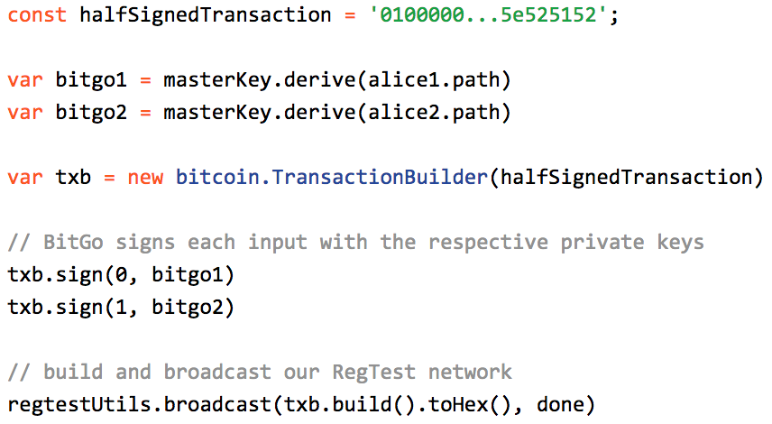
How does multisignature work?

Slide 10

Multicurrency Multisignature
https://github.com/bitcoinjs/bitcoinjs-lib

Slide 11

Multicurrency Multisignature
https://github.com/ethereumjs/ethereumjs-tx
https://github.com/ethereumjs/ethereumjs-abi
https://github.com/ethereumjs/ethereumjs-util
Requires 1 on-chain wallet deploy transaction
Makes wallet creation expensive and error-prone

Slide 12

Create Wallet
(1) Contract Deploy

Slide 13

Multicurrency Multisignature
https://github.com/ripple/ripple-lib
https://github.com/ripple/ripple-address-codec
https://github.com/ripple/ripple-binary-codec
https://github.com/ripple/ripple-keypairs
https://github.com/ripple/ripple-hashes
Requires 3 on-chain wallet deploy transactions
Makes wallet creation REALLY expensive and error prone

Slide 14

Create Wallet
(1) Funding Tx
(2) Multisig Tx
(3) Disable Master Key Tx

Slide 15
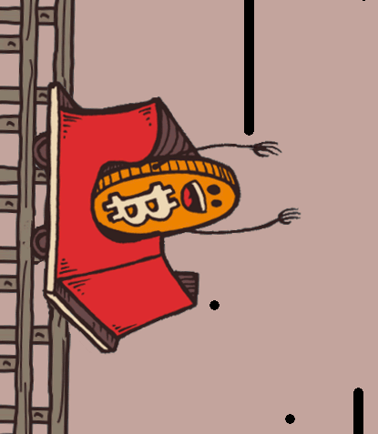
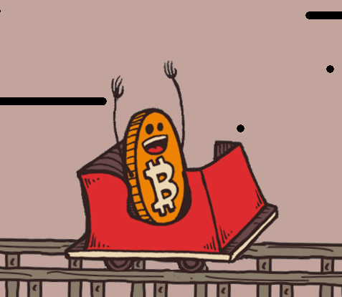
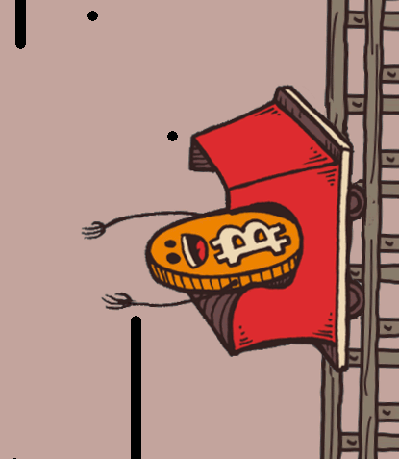
Poll: What is the most important part
of any cryptocurrency wallet?

Slide 16


Slide 17
Key Management Problem
Good wallet will create a new address every time it receives a transaction
Privacy

Slide 18

Key Management Problem
Good wallet will create a new address every time it receives a transaction
Privacy
This means a new private + public keypair for every new address
1PzGm1KM1Tp4ZphQzoejaz6kJPcd4kRrMw

Slide 19
Key Management Problem
Backups are a pain

Slide 20
Key Management Problem
Backups are a pain
Backup

Slide 21
Key Management Problem
Backups are a pain
Backup

Slide 22
Key Management Problem
Backups are a pain
Crash!
Backup

Slide 23
Hierarchical Deterministic Keys (BIP32)
1 master seed
Deterministic method (think hashing) for generating unlimited child keys
You only need to remember one 512-bit string
512 Bit Seed
Seed (hex): 000102030405060708090a0b0c0d0e0f

Slide 24
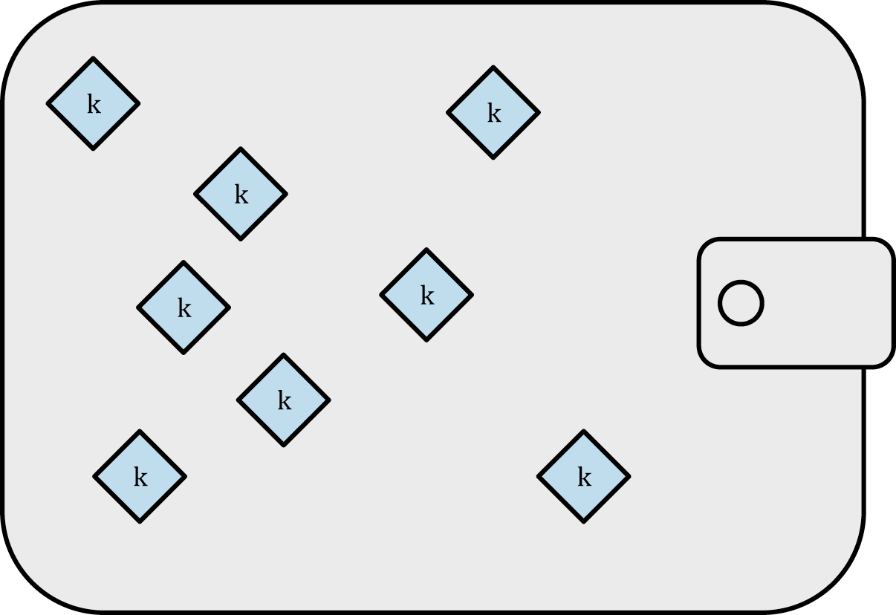
Hierarchical Deterministic Keys (BIP32)
Multiple Private Keys

Slide 25
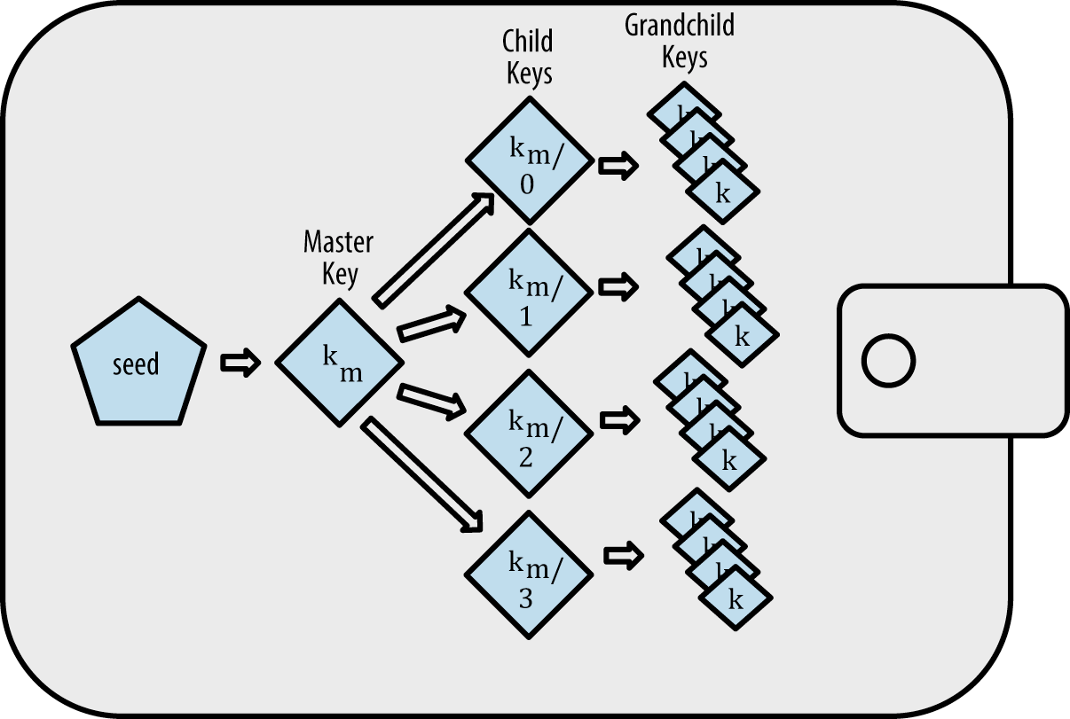
Hierarchical Deterministic Keys (BIP32)
Single BIP32 Seed

Slide 26
Security Takeaway
Prevent single key theft
Be prepared for more development complexity
Simplify key management with BIP32 keys

Slide 27
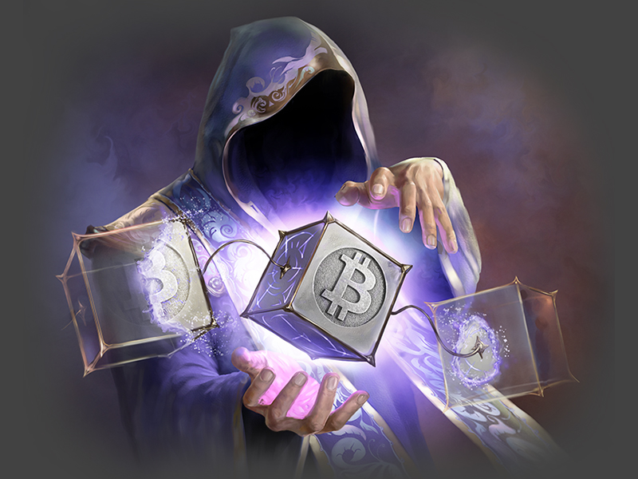
Thanks! ありがとう！

